Slide 1

University of Stirling
Students’ Union
Report for AGM| 2021-22

Slide 2
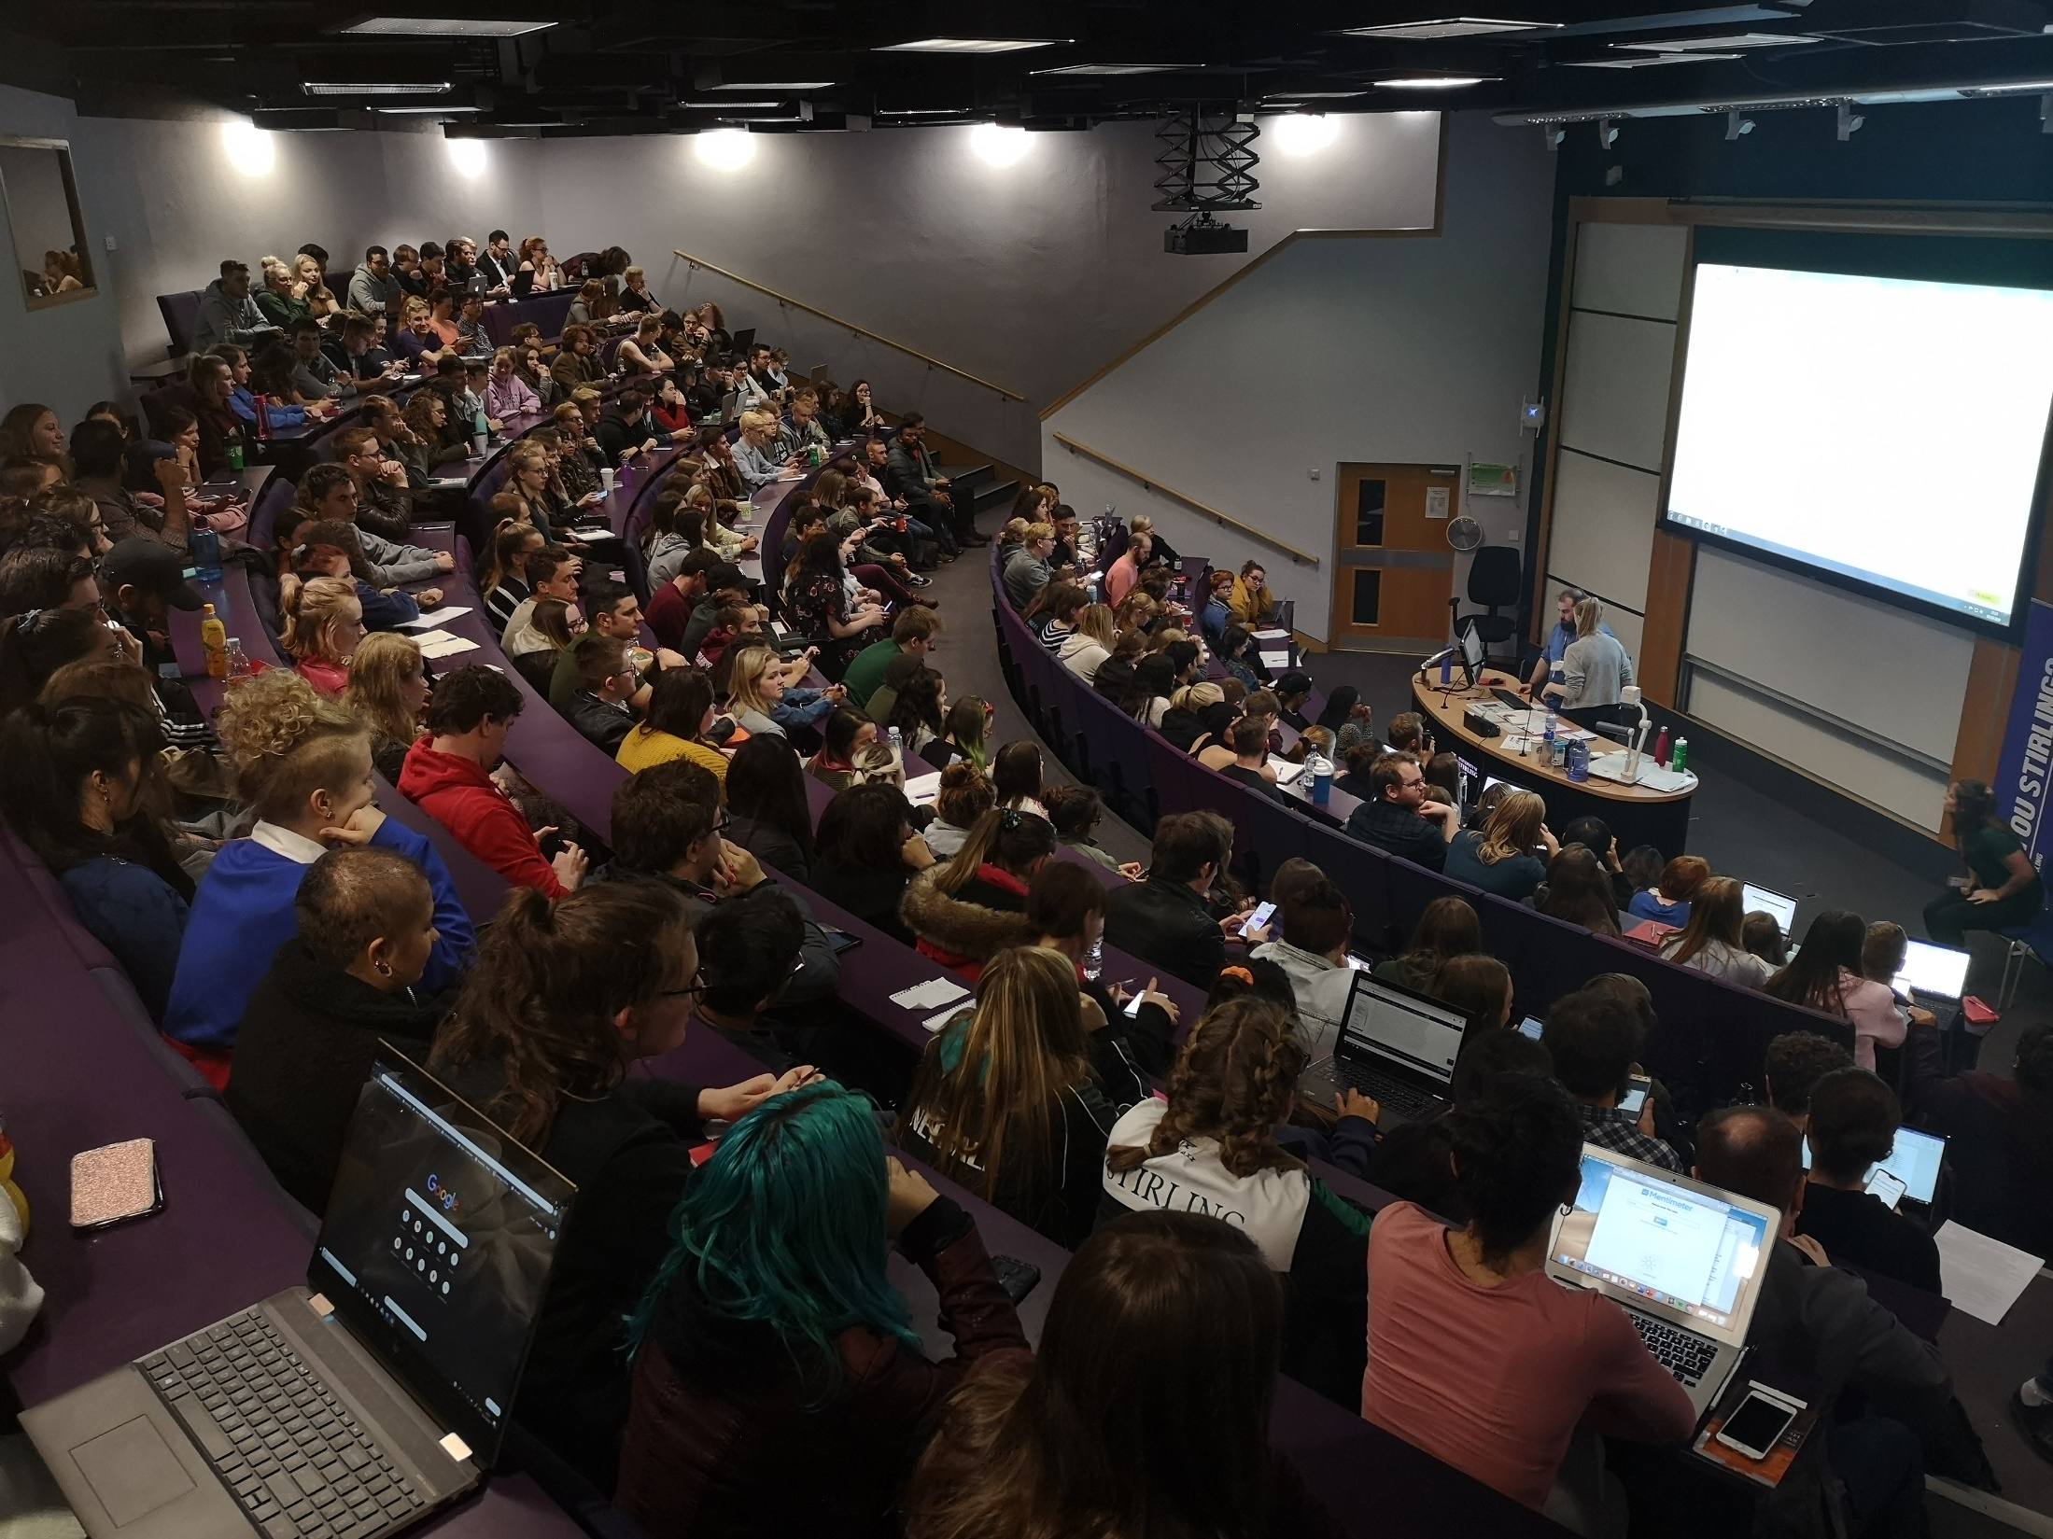
REPRESENTING THE VIEWS AND RIGHTS OF STUDENTS TO THE UNIVERSITY AND BEYOND
23 Faculty Officers across both Undergrad and Postgrad
Circa 700 Module Reps and 160 Programme Reps
Union Elections – 11 out of 23 positions filled, 782 voters with 5434 votes cast
RATE Awards – almost 1000 nominations
Sticking with online Zones and GMs, kept up attendance and engagement
Multiple student surveys, consultations, policies and reviews.
Learning and adapting to the hybrid learning environment and impacts to students
Return to in person teaching and events

Slide 3
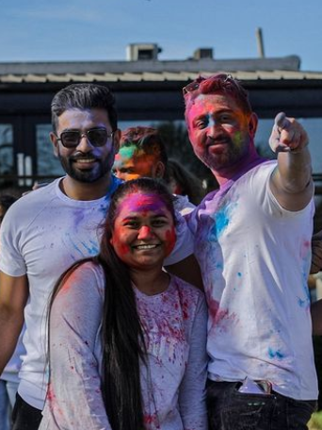
ENHANCING THE STUDENT EXPERIENCE THROUGH CAMPAIGNING FOR POSITIVE CHANGE & SOCIAL JUSTICE
Black Lives Matter and Black History Month – supported events with the BAME Officer and showcased art by Black students.
Movember Campaign raised over £20k.
Instead of using the Rainbow Laces campaign our sports teams dressed as the rainbow for training to show support of LGBTQ+ people in sport.
16 Days of Action – awareness raised by the Sabbatical Officers, Womens Officer and others.
Inspirational Women Awards – Successfully held in person for the first time
Sabbatical Officers attended an NUS Rally for a #NewVisonForEducation (28th Feb) and hosted a rally and Walk In Teach Out event on Campus (2nd March)
Erase The Grey - Worked closely with the University to create and launch the new gender based violence campaign
Period Poverty – Free delivery of period products to Stirling students. Data collected by our Period Poverty Inter, results out soon. During Period Pride week (w/c 11th April)

Slide 4
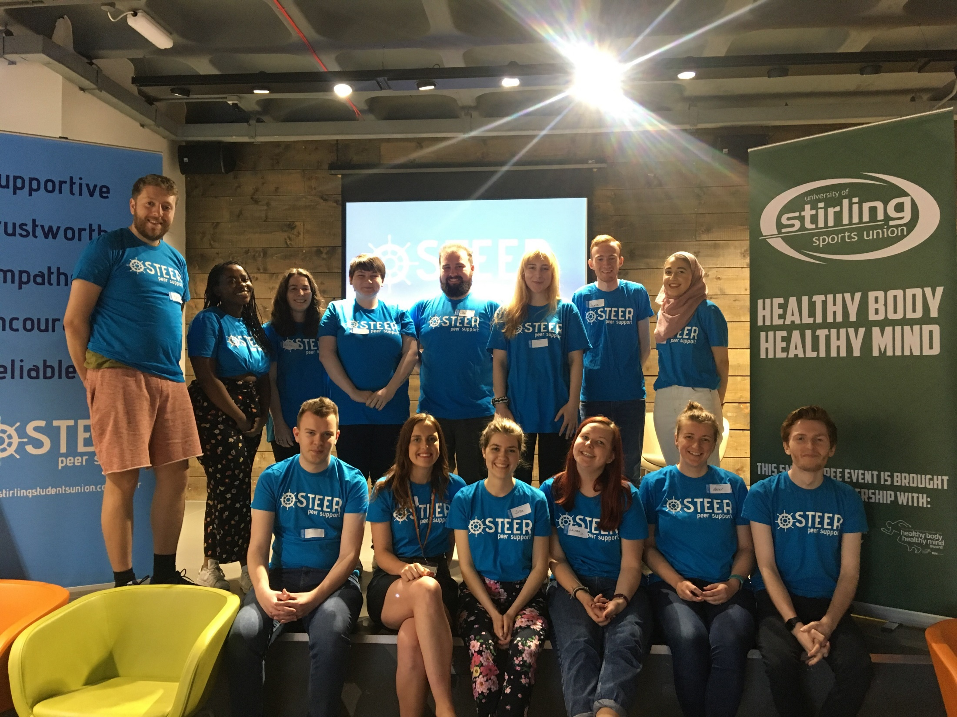
EMPOWERING STUDENTS TO DEVELOP THEIR RESILIENCE & WELLBEING THROUGH PARTICIPATION IN CO-CURRICULAR ACTIVITIES
Continuing work on developing the Mental Health Strategy
Clubs and Societies creating innovative and new ways to continue to engage students online
STEER peer support and volunteering opportunities
Clubs & Socs Ball – multiple nominations and great in person event
Collaborating with the University on Wellbeing Week, Green Week and many more all of which featured in the BeConnected programme
EDI work – Leading to prevent training, Erase The Grey, attendance of the 2022 NUS Liberation Conference
Union awarded Investors in Diversity accreditation following direct feedback from students

Slide 5
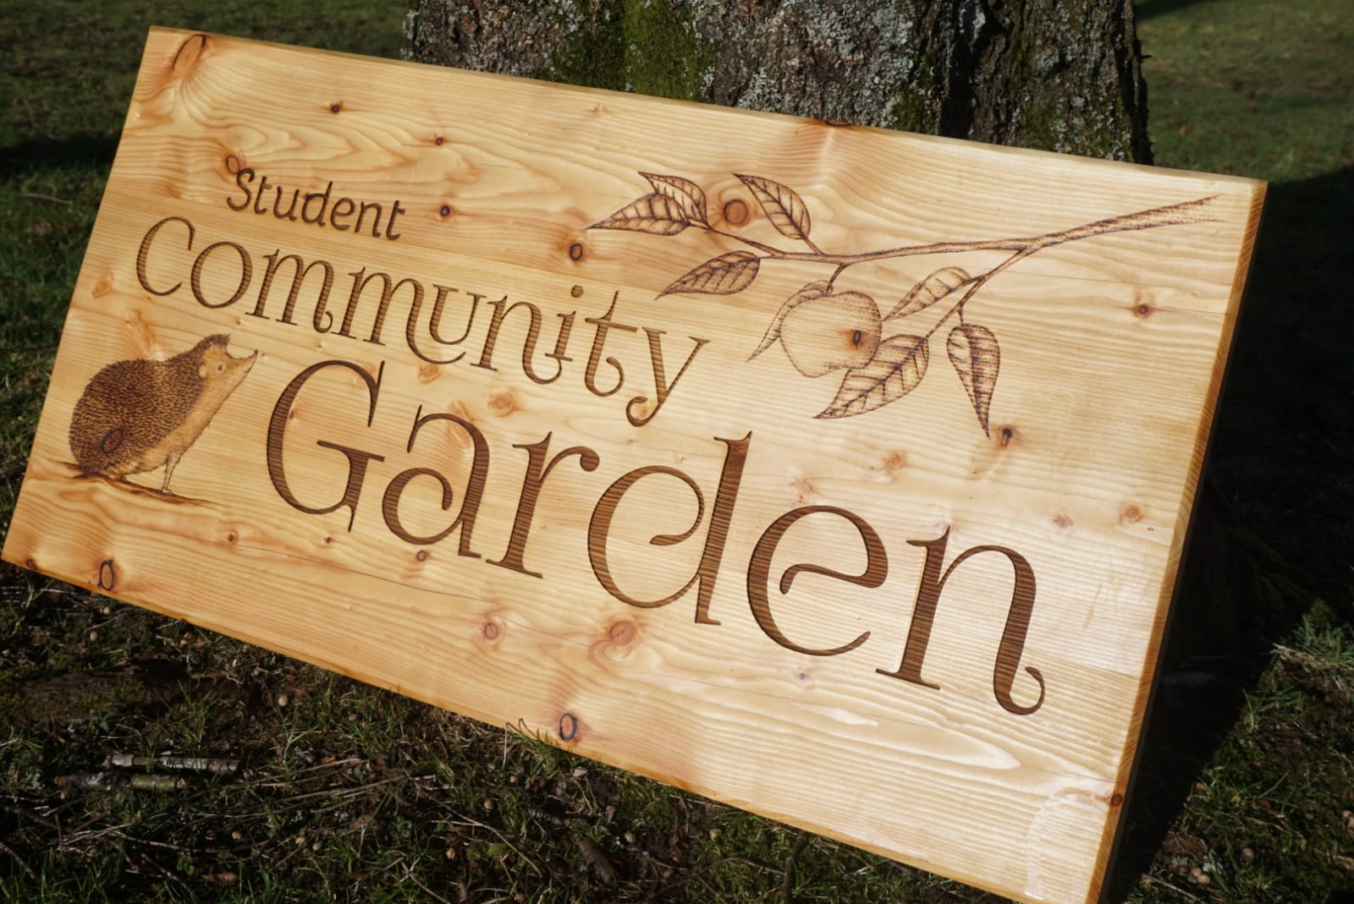
FACILITATING STUDENTS TO POSITIVELY ENGAGE IN ENVIRONMENTAL, ETHICAL & SUSTAINABILITY ISSUES
Continuing work to remain a Carbon Neutral Students Union
New Green and Blue Space opened
Continued work to maintain the Community garden
Launched Student Climate Emergency Working Groups
Stirling Campus is recognised as a Silver Level Hedgehog Friendly Campus thanks to the work of our Environmental Enterprise Society's Hedgehog Team.
Contributed to the University Sustainability Plan and got the date for being carbon neutral down to 2040 (from 2045)
Supported the continued presence of NextBikes on campus and in Stirling city centre
Stirling Climate Festival was a huge success!

Slide 6
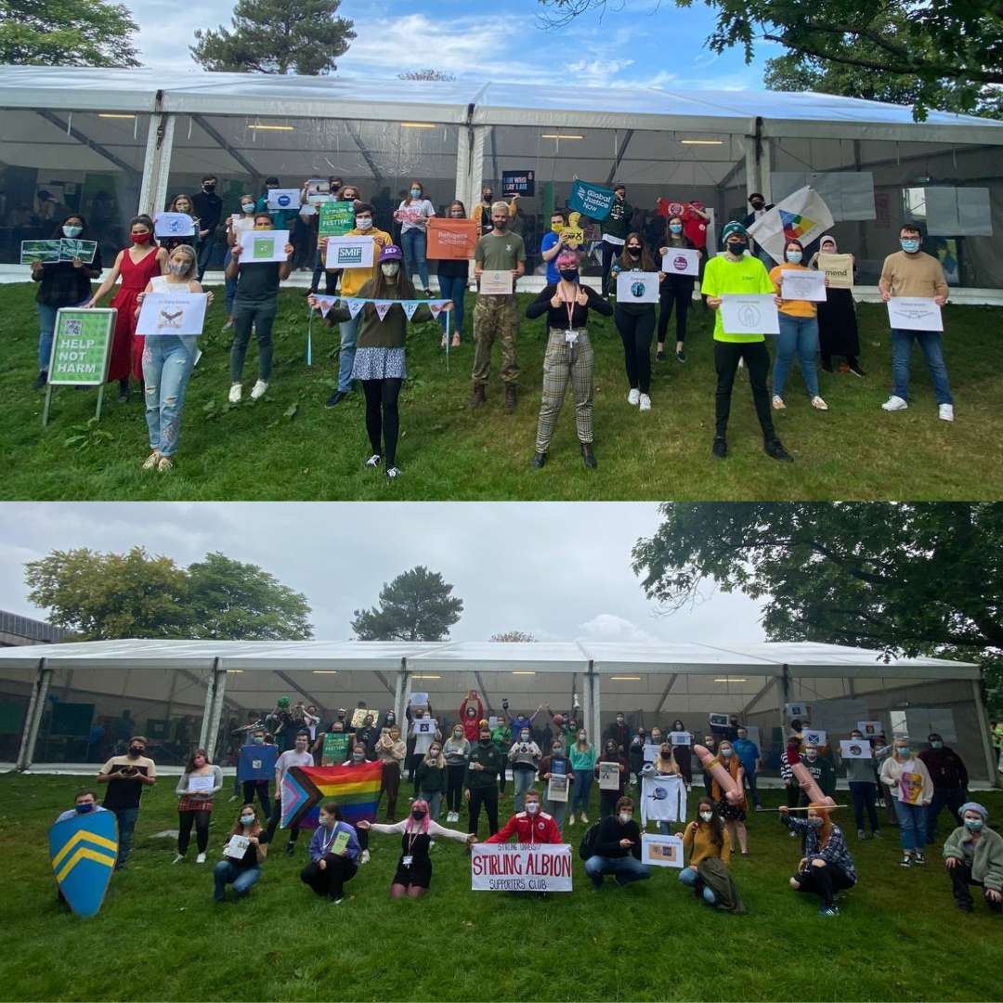
Clubs and Societies at Stirling Students’ Union
Many Clubs & Socs creating innovative and new ways to engage students online
Over 1400 Clubs & Socs members
82 Clubs & Societies
Thousands of pounds and much awareness raised for various charities including. £2,000 raised during Action for Ukraine Week alone.
Hundreds of club collaborations within the Union & University community e.g. Careers & Employability, Faculties and many other local, national and international organisations
Multiple award-winning Clubs & Societies
Nearly 100 students engaging in the STEER Peer Support Programme
Number of students engaged in Pandemic Pals – over 200
Extremely successful Clubs and Societies Awards ball with 15 awards across many groups.

Slide 7

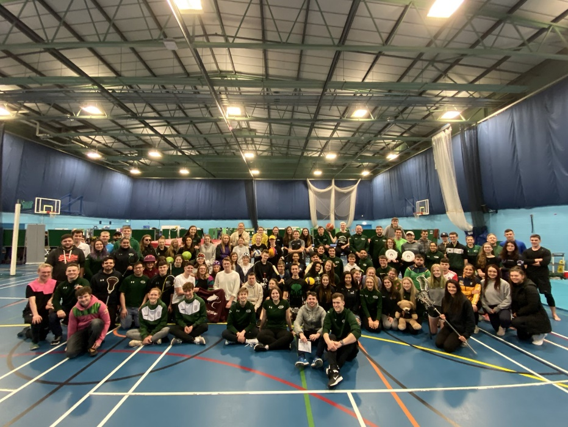
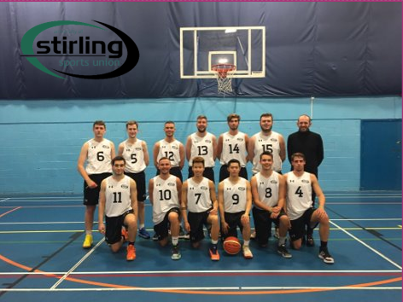
Sports Clubs at Stirling Sports Union
Over 2000 Sports Union members, which is back up to pre-covid levels
We invited 5 new clubs into our fold
We ran our first Varsity event with St Andrews, with 21 teams competing across 2 universities
We welcomed back a number of campaigns in person including Movember (raising over £20k), Green Ribbon Campaign (kick-starting the sport swap trend) and #SportForAll (promoting accessibility in our clubs).
We had 6 teams reach the SSS Conference Cup Finals
Our Men's Football 1s retained their BUCS Premier League North title
We had several athletes selected to represent the SSS national squad in cycling and athletics
Gabriella Wood became an Olympian in Tokyo 2021 and BUCS Judo Champion in 2022
We are currently sitting 12th in BUCS with 30 teams sitting either 1st or 2nd in their league

Slide 8
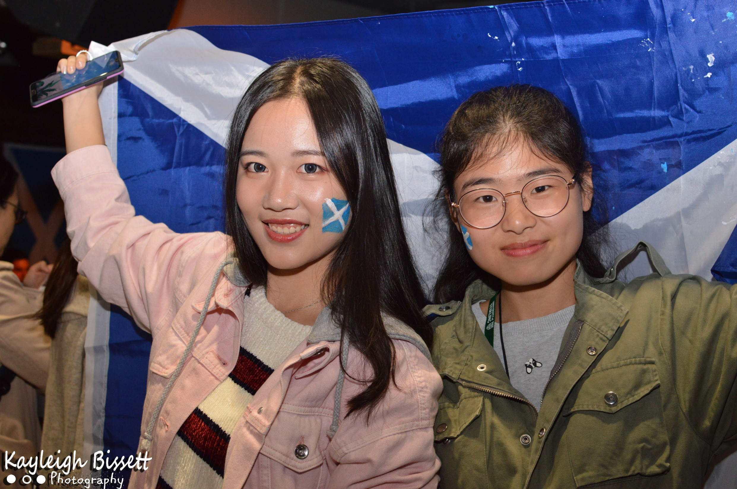
PROVIDING SECURE & ATTRACTIVE SPACES FOR STUDENTS TO STUDY, SOCIALISE & RELAX
Adapting various Union activities, great Freshers Week and ReFreshers including online support
Supporting clubs, societies, elected officers, and academic representative training in hybrid way
Quality Students' Union – accreditation for the Union
Union venues open for students to enjoy – blend of online ordering and paying in-person
Use of Venue by clubs, socs and sports teams
Union shortlisted for 3 NUS Scotland Awards including Students' Union of the Year

Slide 9

Financial Report
Union accounts for 2020/21 available on the Union website

Slide 10
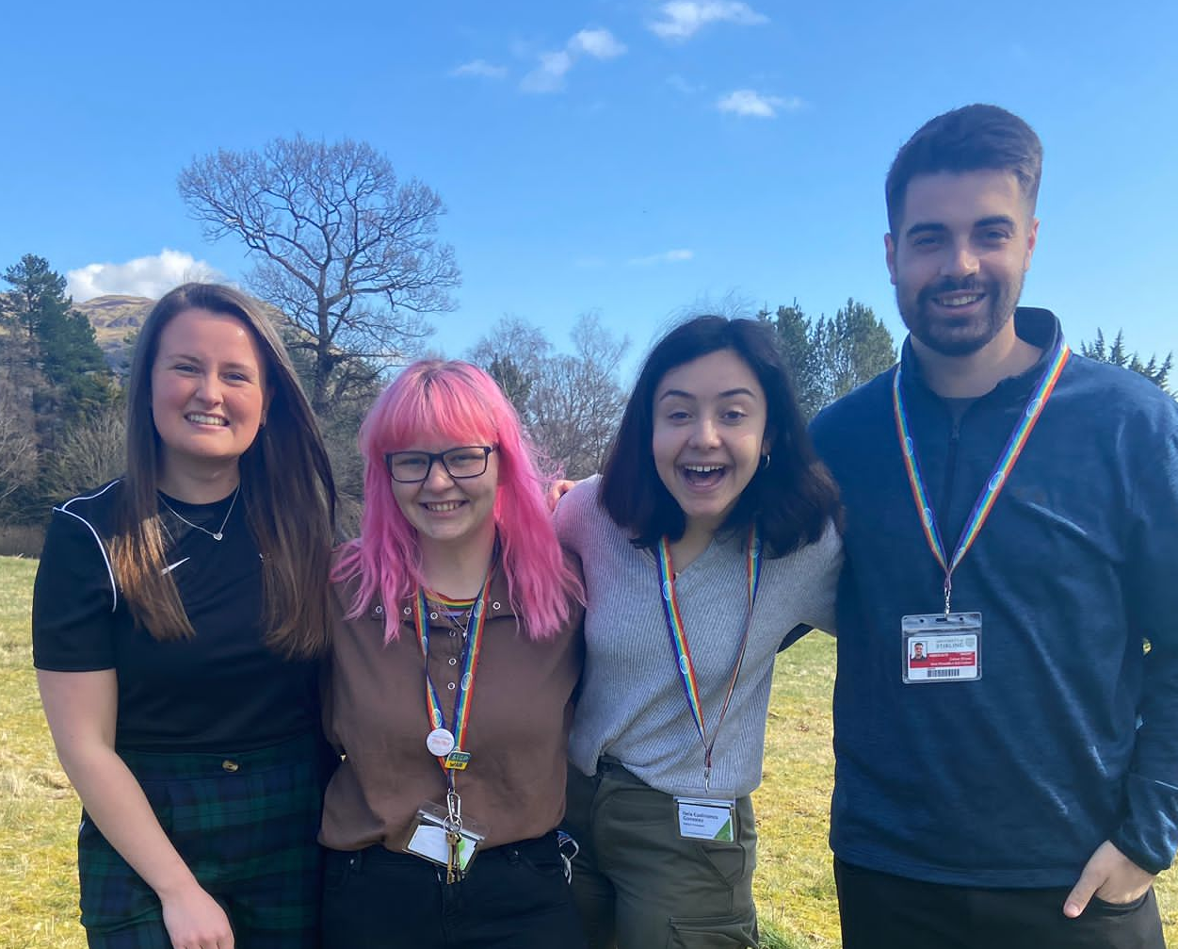
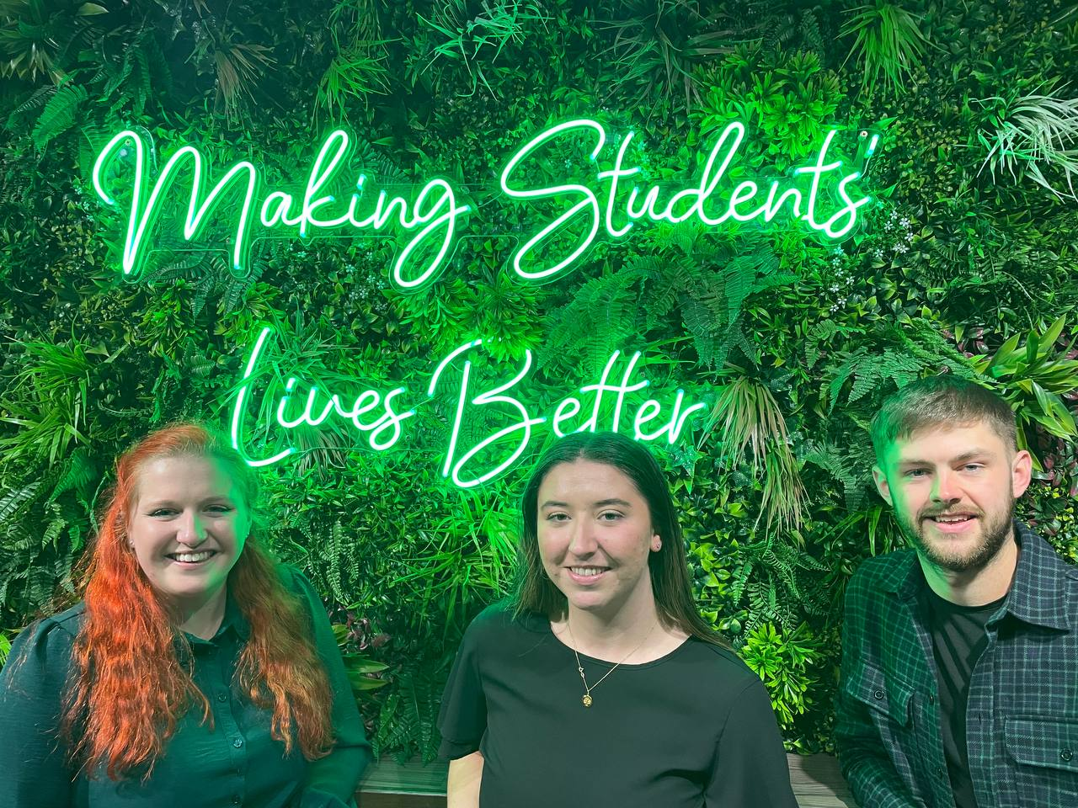

The Future
Keep on Making Students’ Lives Better
¾ New Sabbatical team elected for 2022/23 - VP Education By Election nomination period launching April 11th.
Learning as a Union from the pandemic and how we can become more accessible to all students
Supporting students during our increased return to in person, as we now begin to move out of the pandemic

